Slide 1
KPMG Marketing Strategy Data Analysis
File created on: 2020-08-22 11:24:06 PM

Slide 2
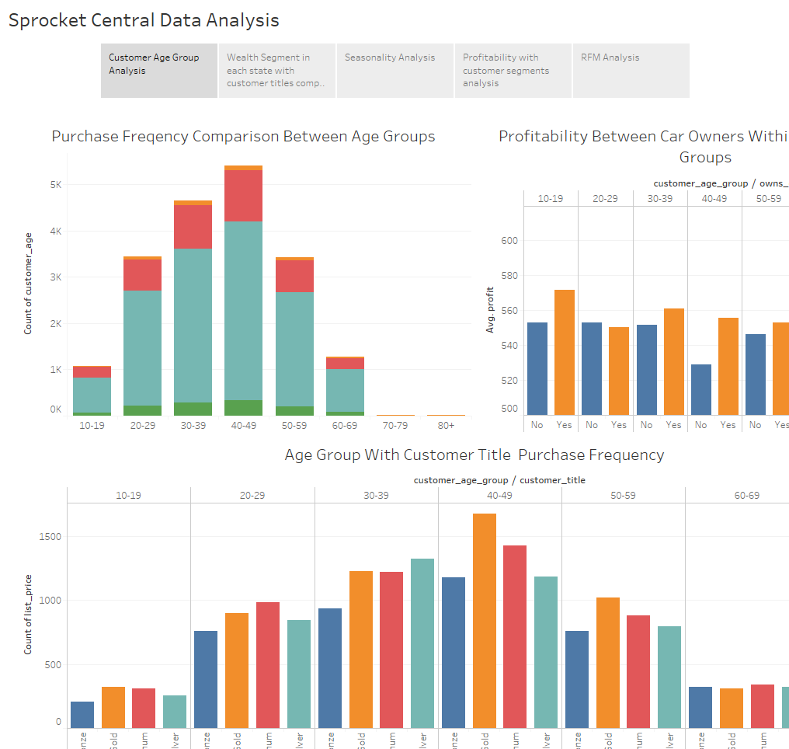

Slide 3
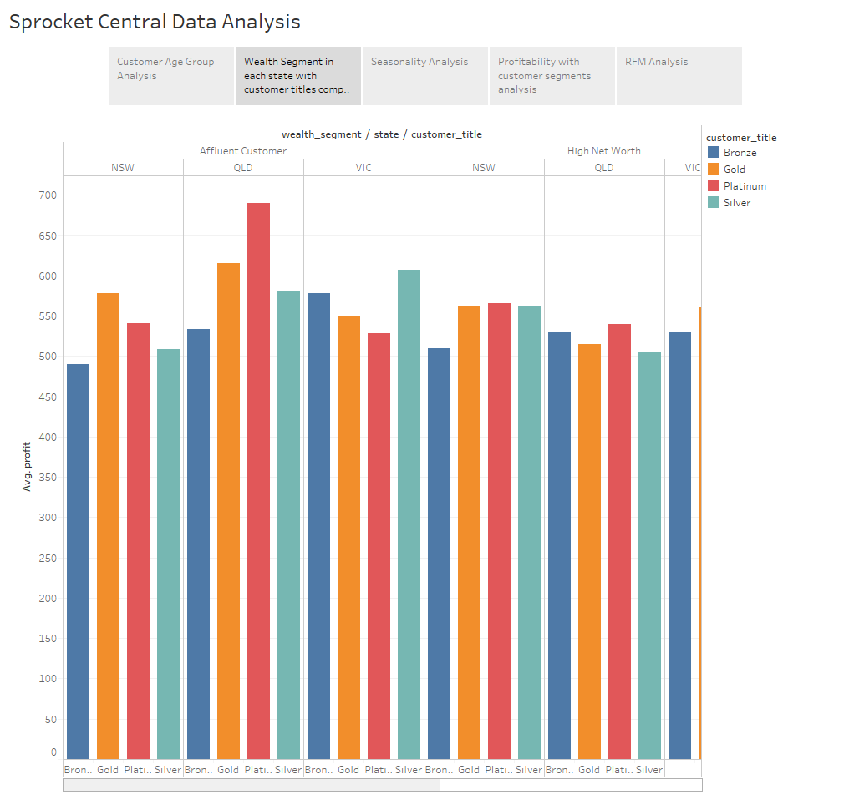

Slide 4
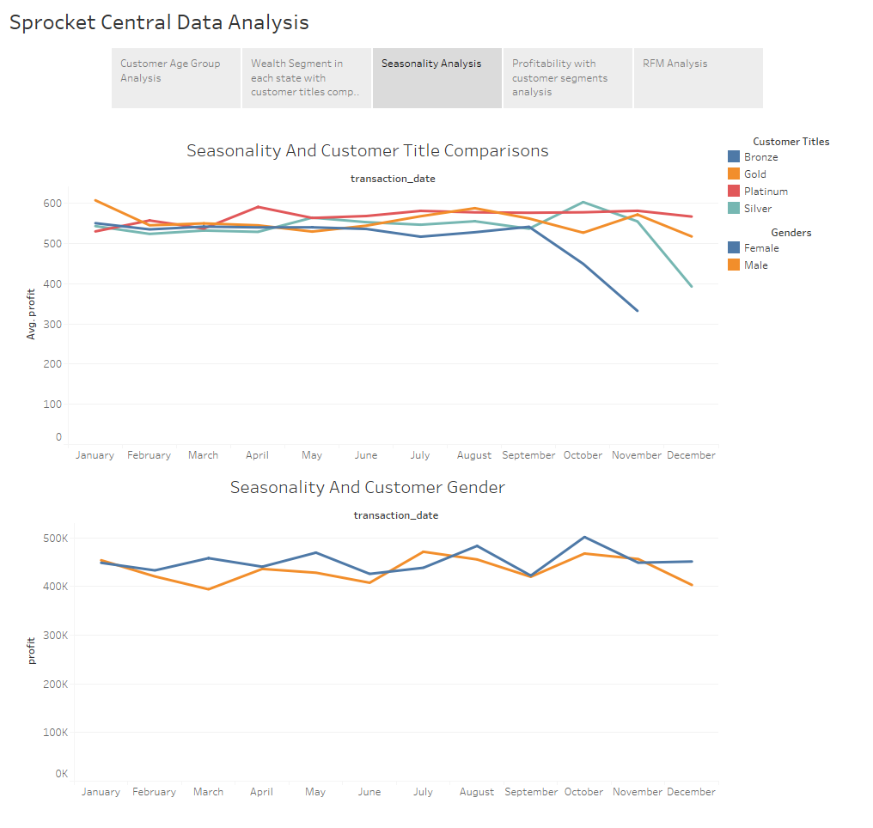

Slide 5
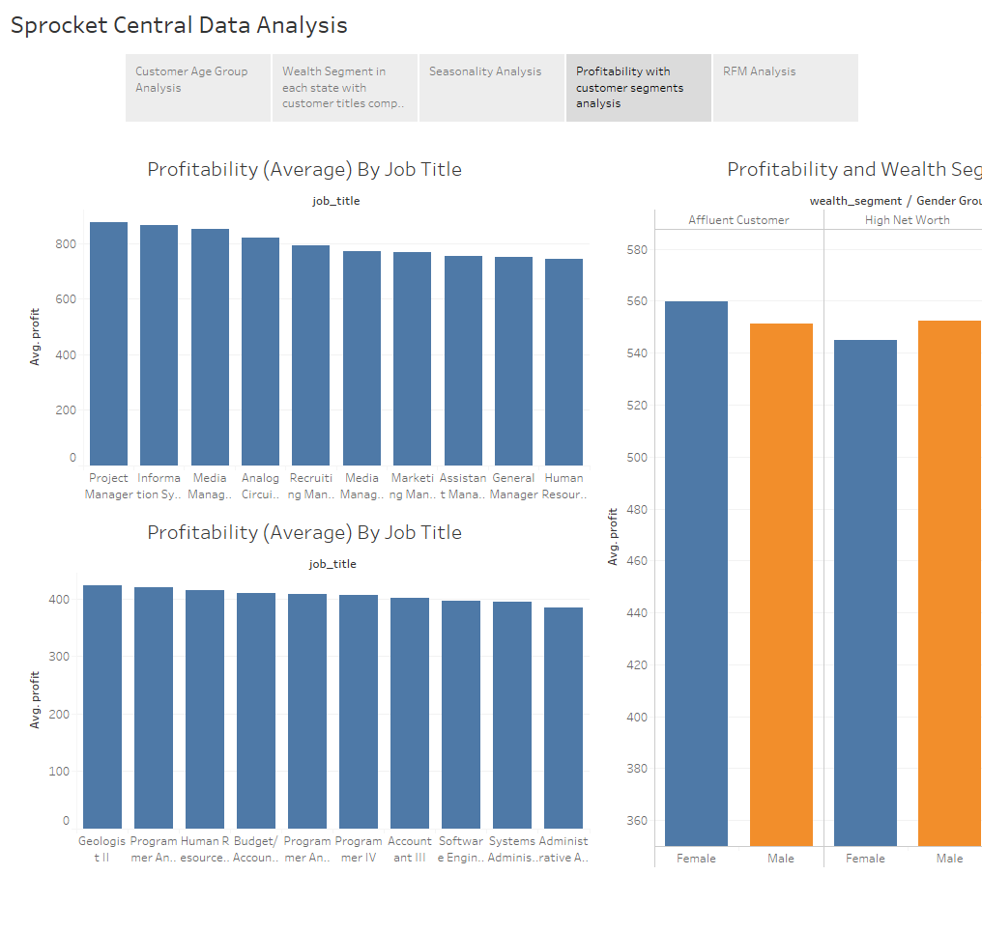

Slide 6
